Slide 1
Course Name: Database Management System
Course Code: CS116
Dr. Praveen Kantha

Slide 2
NORMALIZATION

Slide 3
There are two approaches to logical database design:
The Top-down approach: E-R Model
The Bottom-up approach: Normalization
The top-down approach
The E-R modeling technique is the top-down approach.
It involves identifying entities, relationships, and attributes, and drawing the ER diagram.
The Bottom-up approach:
Normalization is the bottom-up approach.
It is a step-by-step decomposing of complex records into simple records.

Slide 4
“Normalization reduces redundancy using the principle of non-loss decomposition. Non-loss decomposition is the reduction of a table to smaller tables without any loss of information”

Slide 5
Why Normalize a Database?
There are a few reasons we would want to go through this process:
Make the database more efficient
Prevent the same data from being stored in more than one place (called an “insert anomaly”)
Prevent updates being made to some data but not others (called an “update anomaly”)
Prevent data not being deleted when it is supposed to be, or from data being lost when it is not supposed to be (called a “delete anomaly”)
Ensure the data is accurate
Reduce the storage space that a database takes up
Ensure the queries on a database run as fast as possible

Slide 6
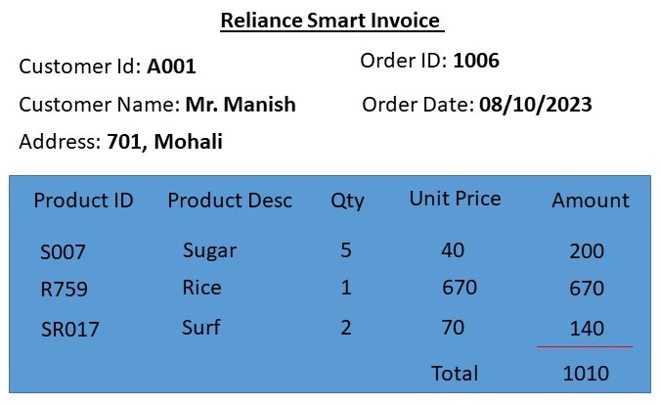

Slide 7
Customer Id | Customer Name | Address | Order ID | Order Date | Product ID | Product Desc | Qty | Unit Price | Amount | Total
A001 | Mr. Manish | 701, Mohali | 1006 | 08/10/23 | S007 | SUGAR | 5 | 40 | 200 | 1010
A001 | Mr. Manish | 701, Mohali | 1006 | 08/10/23 | R759 | RICE | 1 | 670 | 670 | 1010
A001 | Mr. Manish | 701, Mohali | 1006 | 08/10/23 | SR017 | SURF | 2 | 70 | 140 | 1010
A002 | Mr. Manish | 607, Kharar | 1007 | 09/10/23 | SR017 | RICE | 1 | 670 | 670 | 670
The issue in Un-normalized table
It is not possible to uniquely retrieve a record for Customer “Mr. Manish”
If you want to update the address of “Manish” then we have to update (4 records) including Cust_Id A001 & A002
If we want to add a new product “shampoo” to the store then it is difficult to insert.
If we want to delete any product from the store then all related records have to delete.

Slide 8
Anomalies
Anomalies means problems or inconsistencies that happened during the operation performed on the table.
Anomaly occurs for example
When all the data is stored in a single table.
When data is stored multiple times unnecessarily in the database.
Normalization is used to overcome(solve) the anomalies of the database.

Slide 9
Types of Anomalies:
Insert Anomalies:
An insert anomaly occurs when certain attributes can't be inserted
into the database without the presence of other attributes.
Example: If we register a new customer and assign a new customer cust_id “A002”
then it is not necessary to purchase any product from the store at this moment.
Delete Anomalies:
A delete anomaly exists when certain attributes are lost because of the
deletion of other attributes.
Example: Suppose we want to delete any product from store then all the
information related to that record also deleted.

Slide 10
Update Anomalies:
If we want to update any single piece of data then we have to update all other copies, it comes under update anomaly.
Example: Suppose we want to update the price of sugar is 45 and previously stored data of sugar-related was 40. At this time all the data related to sugar will update to 45, which is wrong.

